Slide 1

Design of the Theme Park
Bicycle Rental System
Group Presentation
Song Ziye Huang Yuyang Tu Teng Ji Xiangtian

Slide 2
01
Introduction
02
Data Analysis & System Design
Content
03
Experimentation
04
Results & Analysis
05
Conclusion

Slide 3
https://www.ypppt.com/
01
Introduction

Slide 4
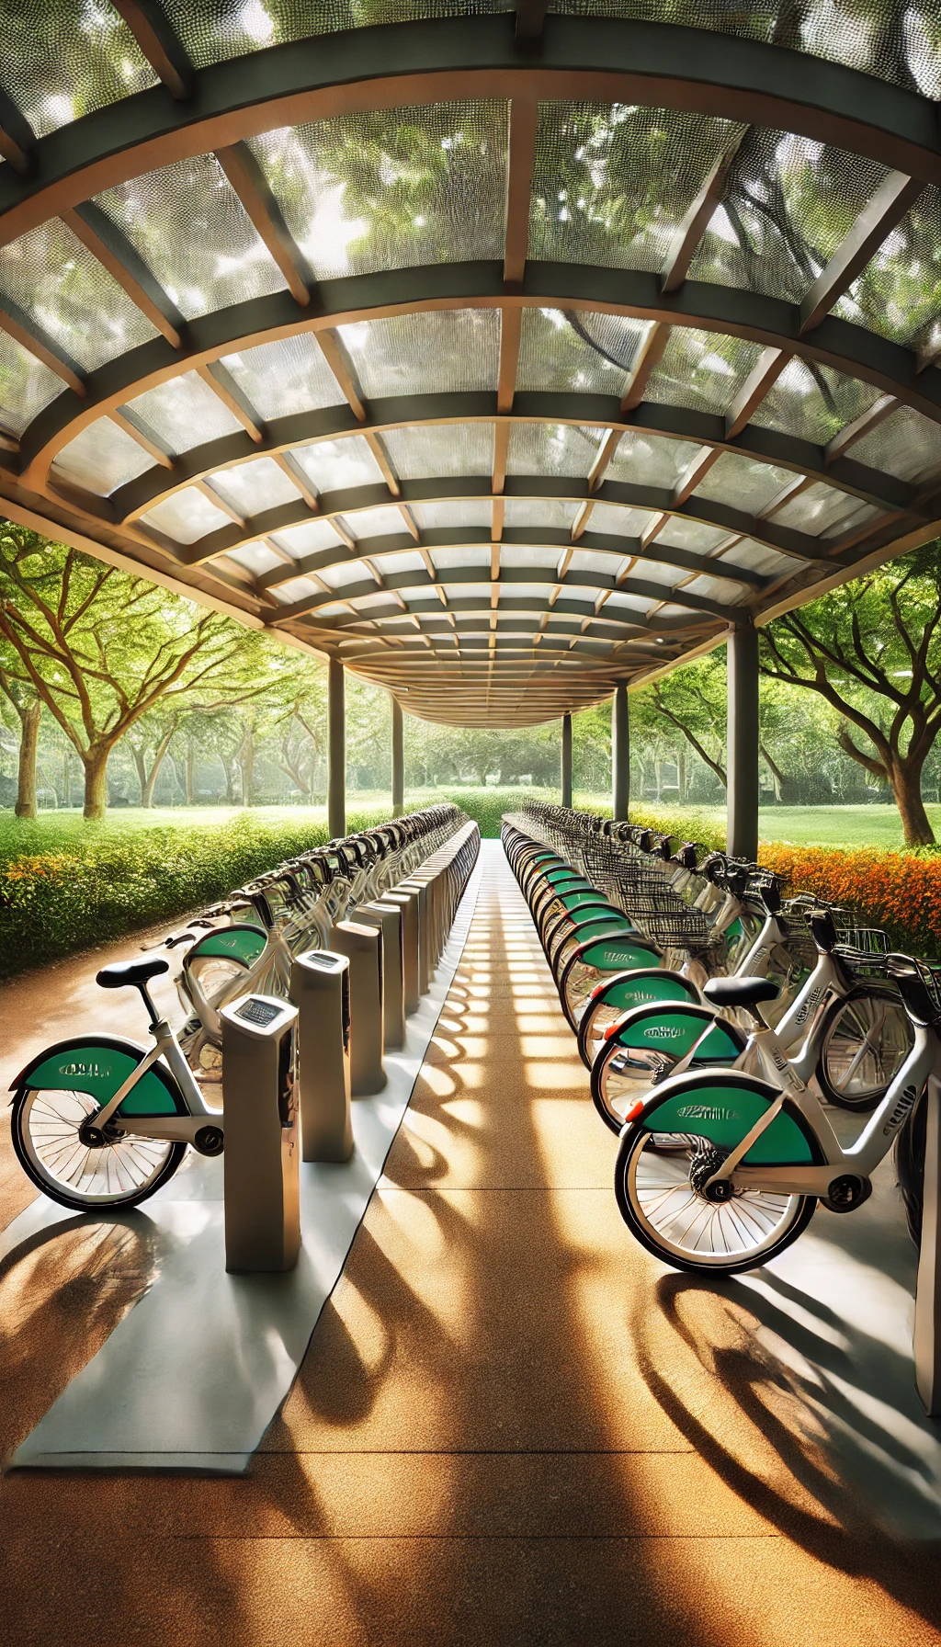
Background Introduction
Popularity Background
In recent years, public bicycle-sharing/rental systems have regained popularity, exemplified by services like Anywheel. Users can rent bicycles from designated stations and return them at their destinations.
Issues
However, common issues include difficulty in finding available bicycles during high demand and the inability to return bicycles during periods of high supply.
Task
Our task is to analyze the bicycle rental system within a theme park and propose improvements to enhance user experience and system efficiency.
part 01
part 02
part 03
part 04

Slide 5
Introduction to Problem Description
Attracitons and Stations:
There are four main scenic attractions in the theme park, each with a bicycle station, identified as A, B, C, and D.
Each station initially has 80 bicycles and an equal number of docking points.
One-Way Roads:
The scenic attractions are connected by one-way roads, and visitors must follow the designated routes.
The distances between routes are as follows: A to B is 2 kilometers, B to C is 2.5 kilometers, C to D is 3 kilometers, and D to A is 1 kilometer.
These roads are wide enough to accommodate visitors but must adhere to the one-way riding rule.
Visitor Riding Rules:
Visitors can start their journey from any scenic attraction and must visit at least 2 attractions and at most 4 attractions.
Each visitor's riding speed within the park is constant, but the speeds vary between different visitors.
01
4 Attractions and One-way Road
02
Bicycles and Bicycle Docks

Slide 6
Introduction to Problem Description
When users want to start their journey, they often find that all bicycles at the station have already been rented out.
This leads to users having to wait for bicycles to be returned, increasing wait times and inconvenience.
01
Difficulty in Getting Bicycles
When users reach their destination, they find that all the docks at the station are full, making it impossible to return the bicycle.
Users have to wait for other users to take bicycles before there are empty docks to return their bicycles, increasing wait times and inconvenience.
02
Difficulty in Returning Bicycles

Slide 7

Introduction to Basic Assumptions
Terminating Simulations
1
Assuming the theme park is open 24 hours, the last few hours of each week are dedicated to cleaning and restoration. Specifically, the park closes at 9500 minutes, during which no new visitors are allowed to enter. Visitors already inside can continue their activities. At 9900 minutes, staff will restore all bicycles to their initial state, and any visitors still waiting in line will receive assistance to leave the queue.
Assumption 1
Visitor Transition Rates
2
Assumption 2
75% of visitors who visit two scenic attractions will proceed to visit a third attraction.
50% of visitors who visit three scenic attractions will proceed to visit a fourth attraction.
3
Bicycle Sale & Dock Exchange
Assumption 3
Assuming the bicycle can be sold for $50, which means two bicycles can be exchanged for one dock.
Queue Simulation & Instant Service
4
Assumption 4
The bicycle pick-up and return in different stations are each simulated with a single queue, ensuring there are no multiple queues. The time for returning and picking up bicycles is completed instantaneously, if resources are sufficient.

Slide 8
Data Analysis & System Design
02

Slide 9
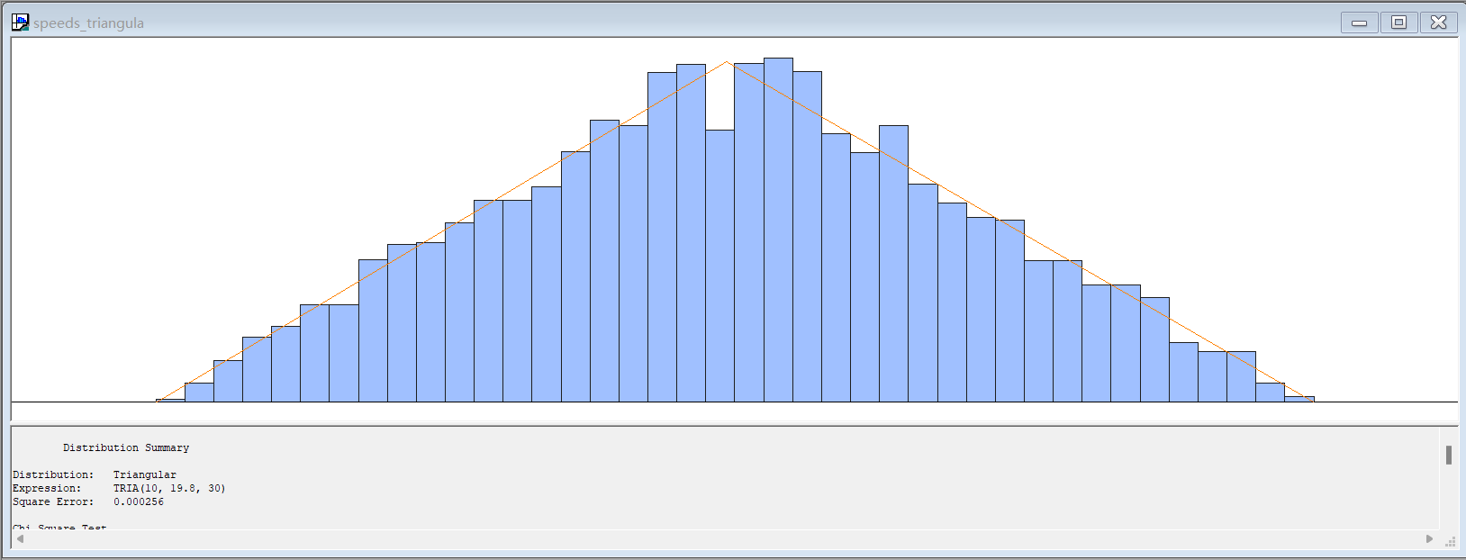
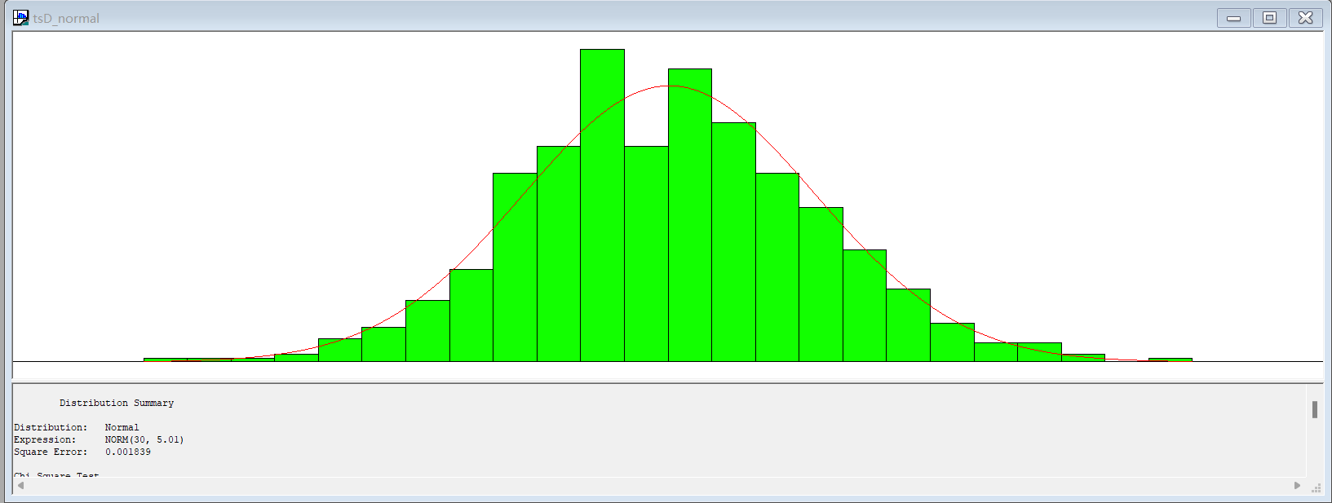
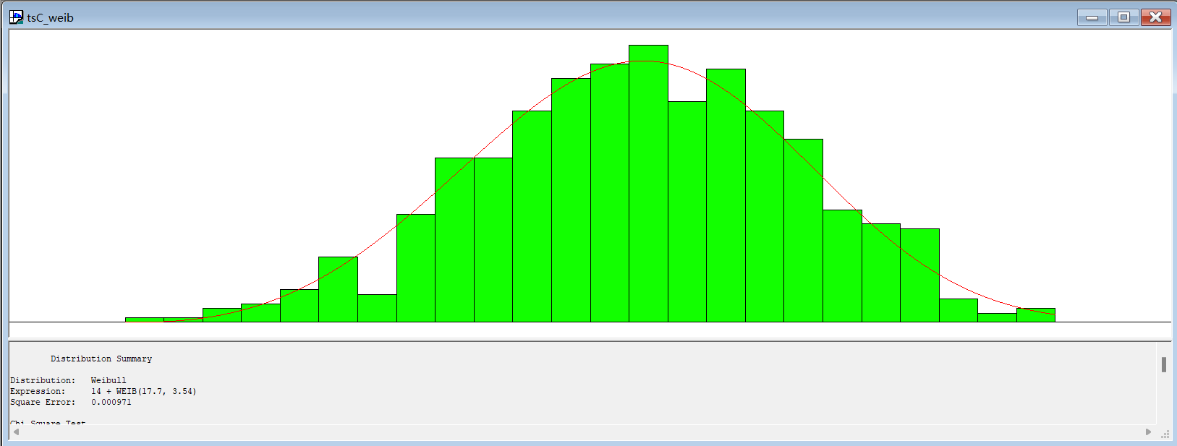
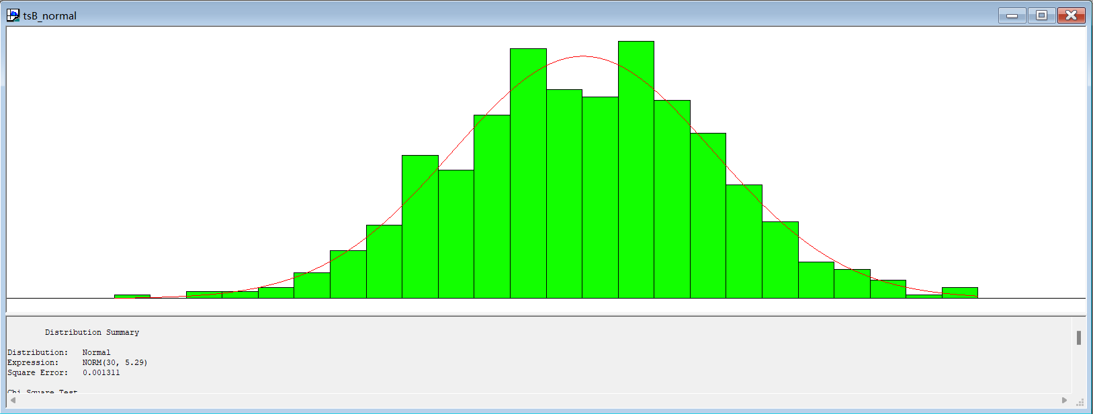
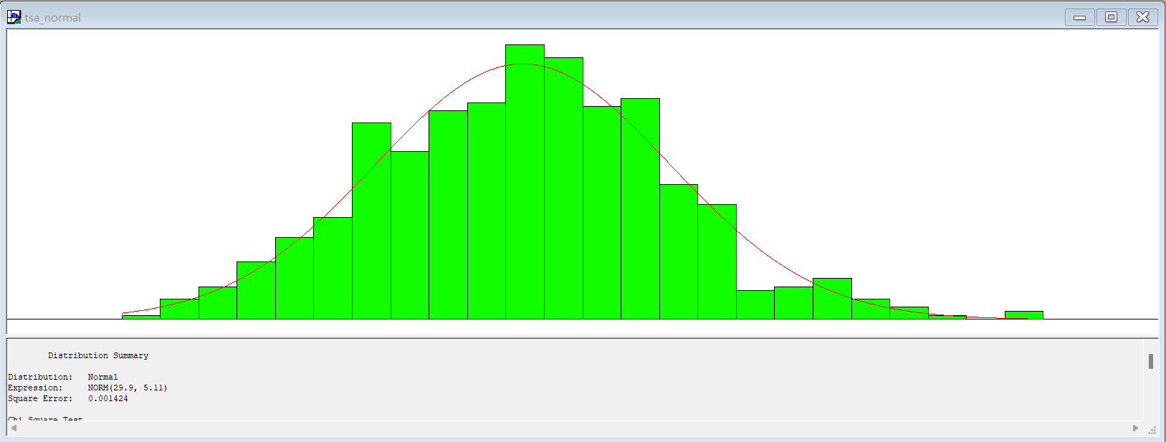
Data Analysis
speeds.xlsx
01
arrivals.xlsx
02
We will discuss this file later.
timespent.xlsx
03

Slide 10
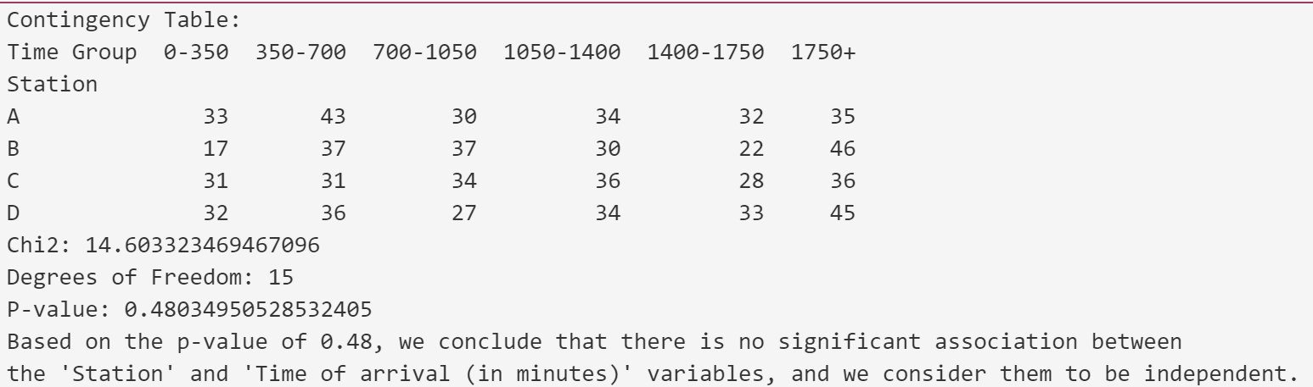
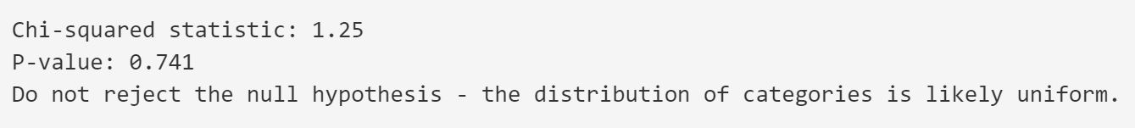
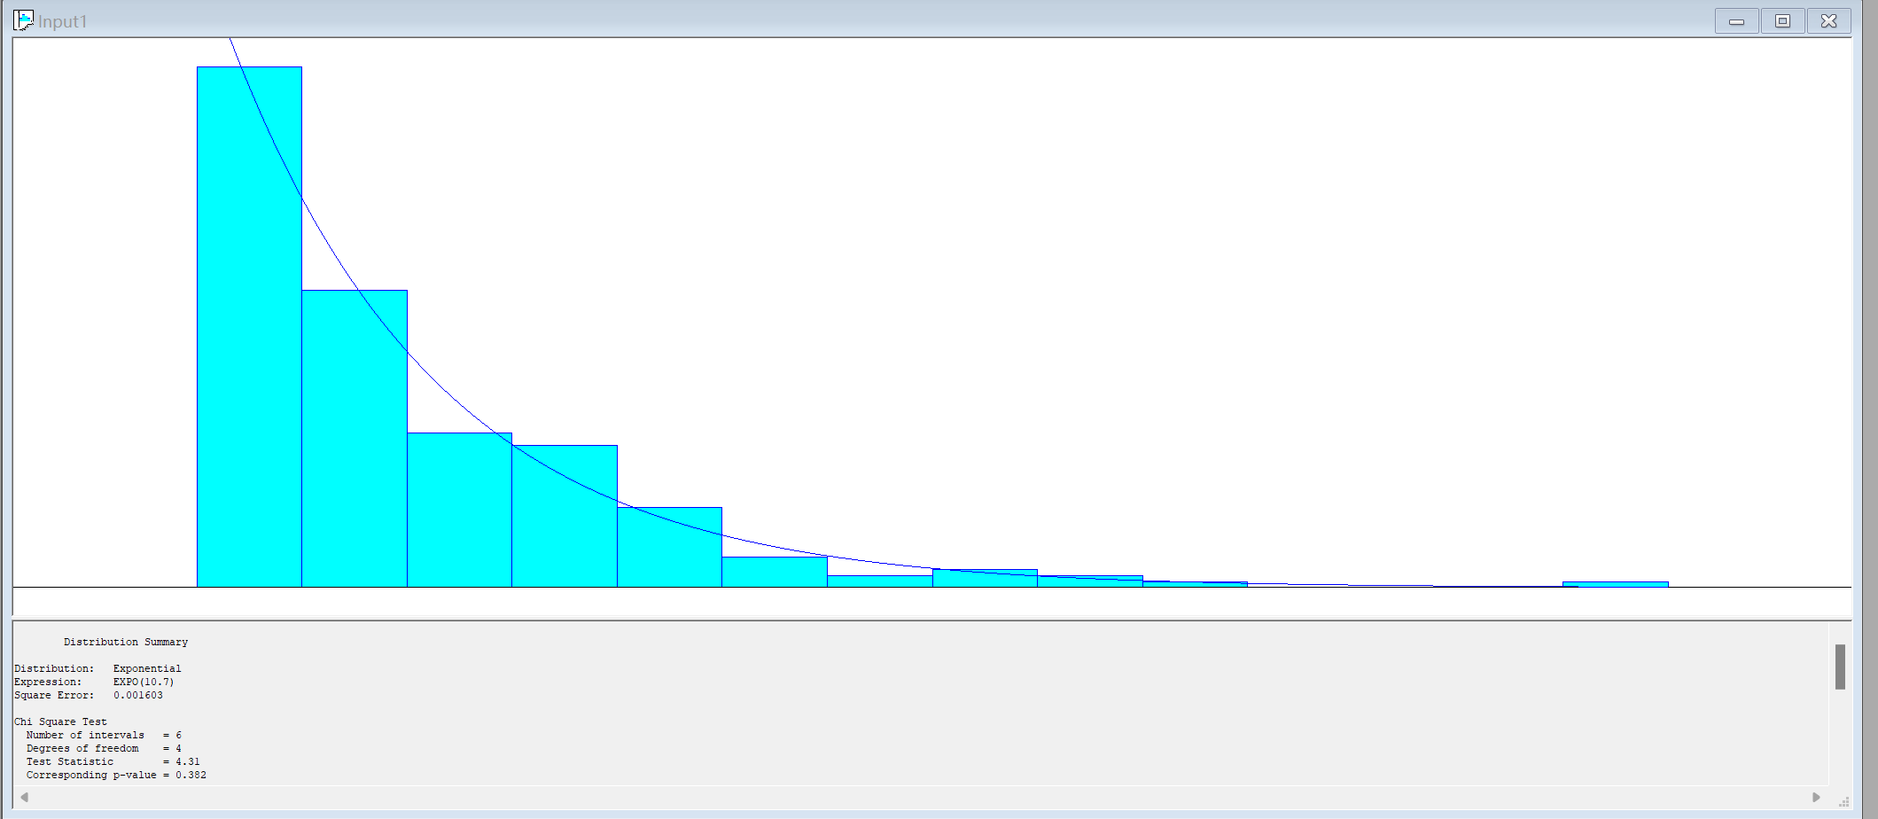
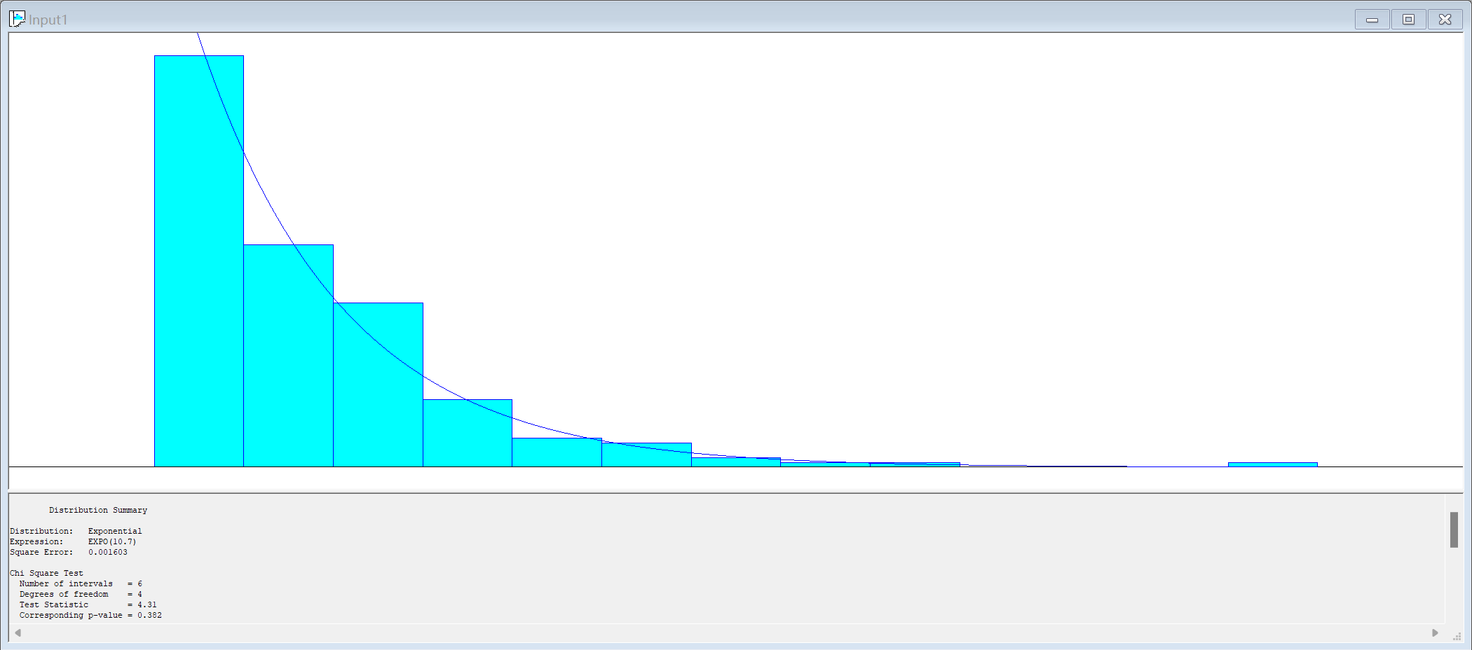
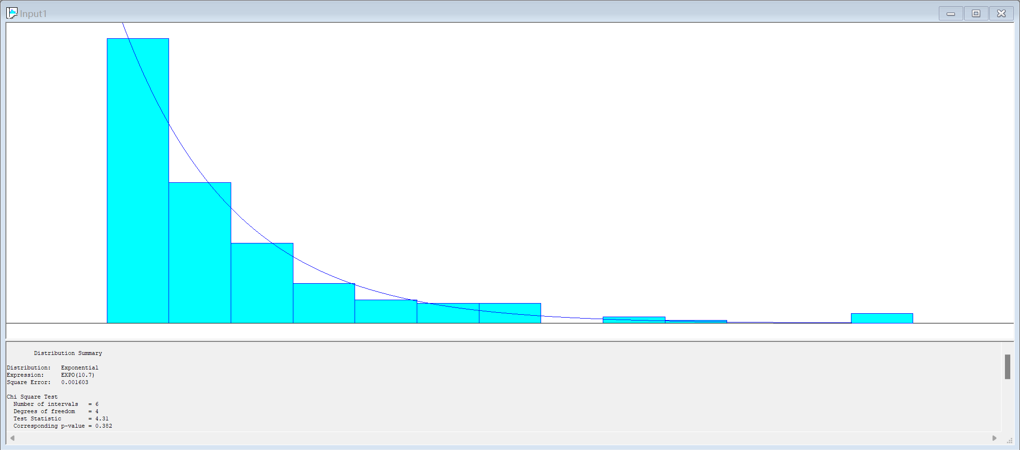
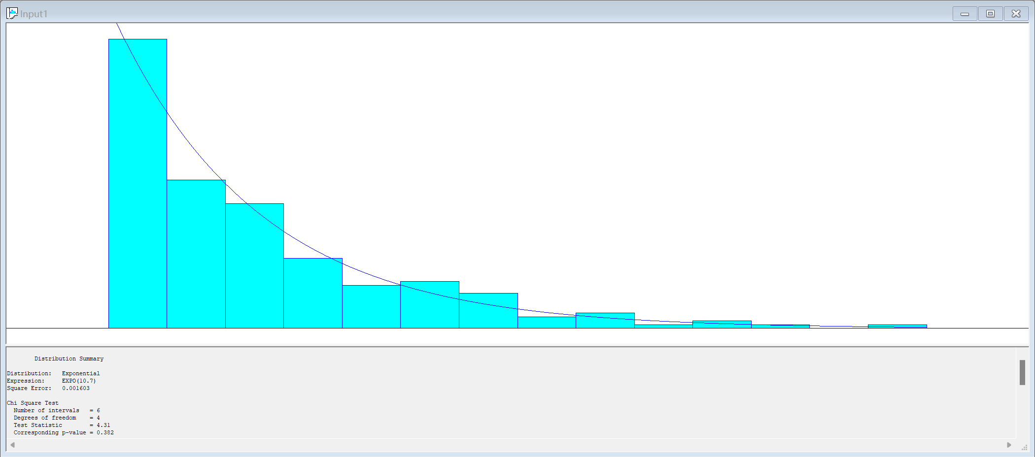
Analysis in arrival.xlsx
01
Pearson's Chi-Square Test for Independence
02
Pearson's Chi-Square Test for arrival distribution independence
03
Fit arrival distribution
In different attractions

Slide 11
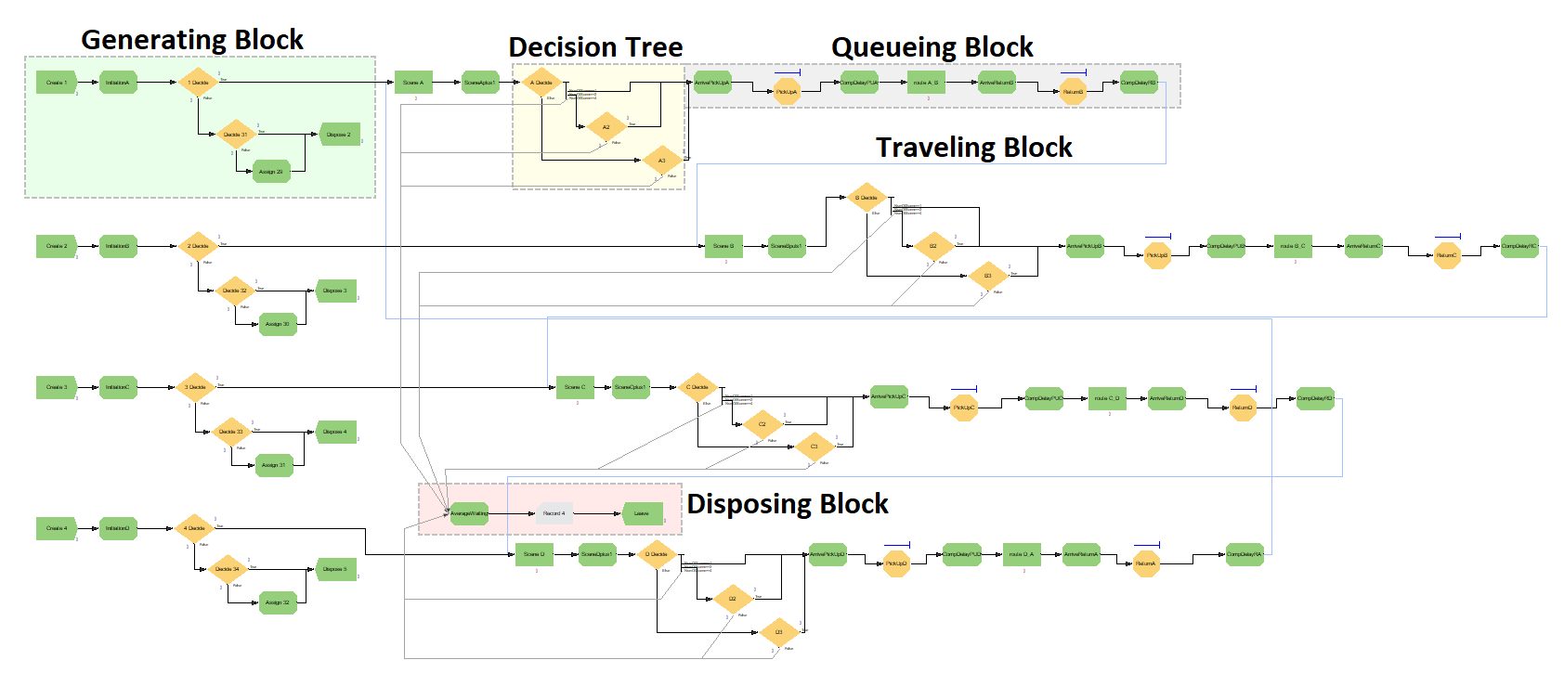
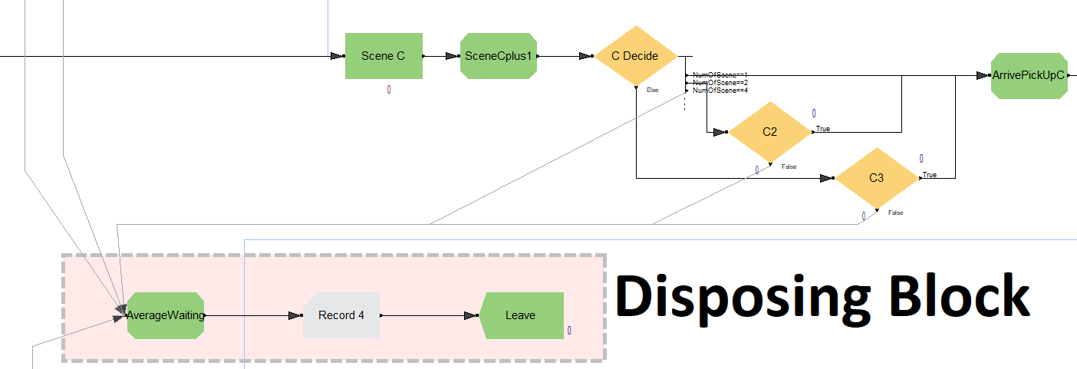
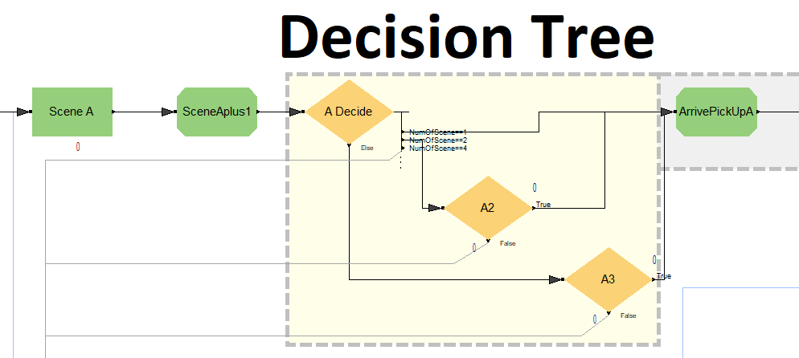
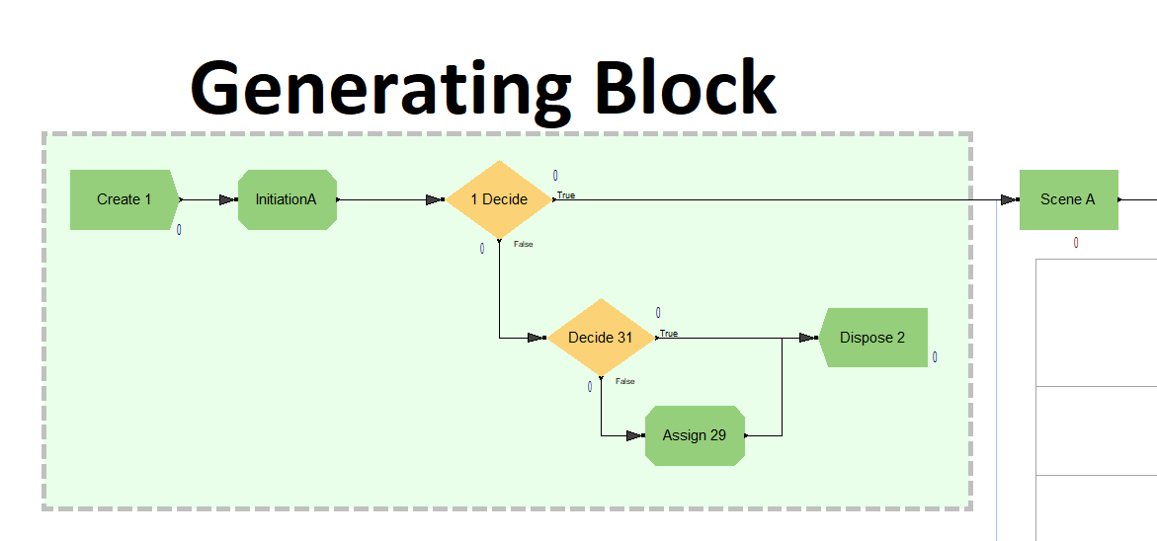
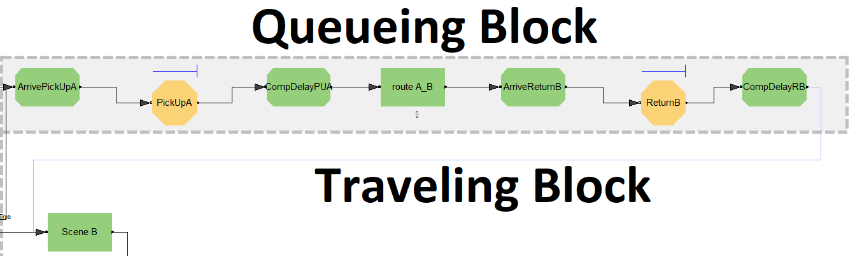
System design
Decision Tree
Disposing Block
04
02
01
03
Genrating Block
Queueing Block & Traveling Block
这里讲关键参数设置，然后如何统计平均等待时间

Slide 12
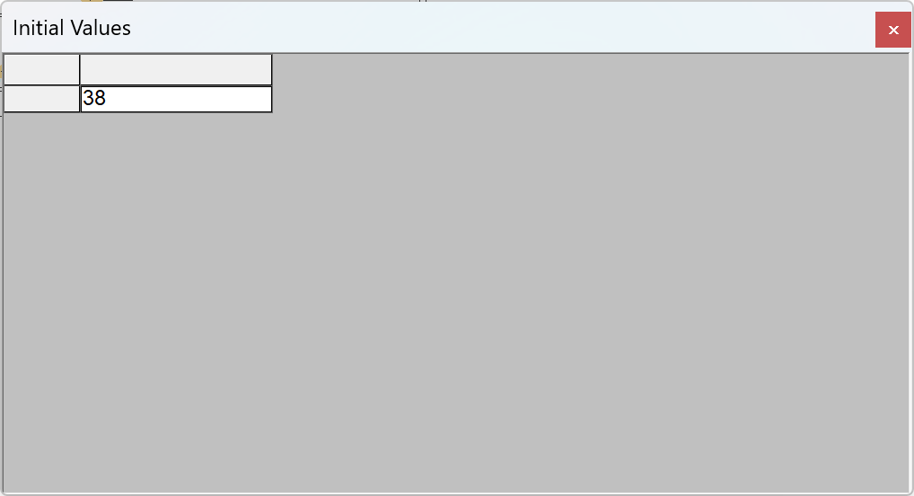
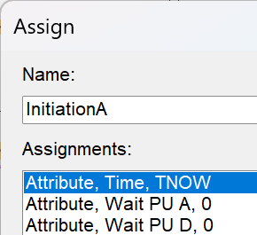
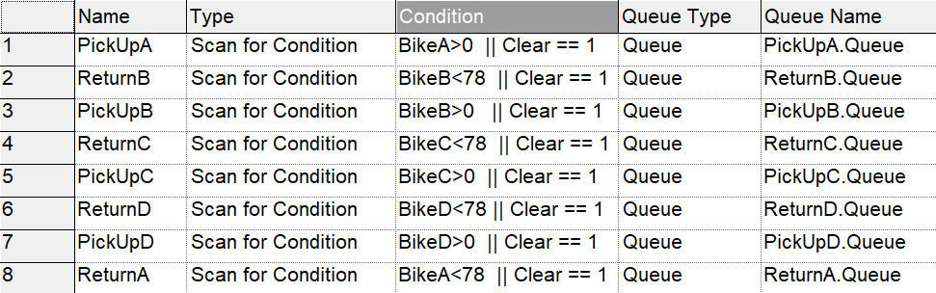
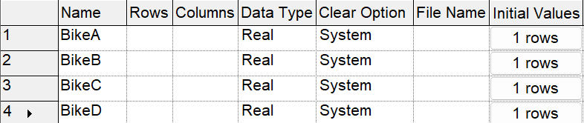
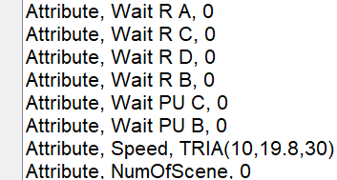
System design
01
02
03
Initiation
Bicycle
Dock
Assign Module
Variable Module
Hold Module
Set Initial Values
Set Condition
PPT下载 http://www.1ppt.com/xiazai/

Slide 13
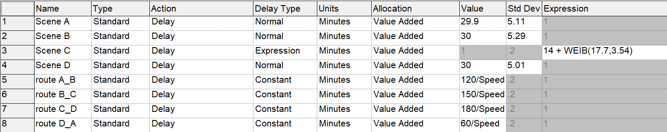
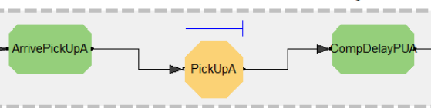
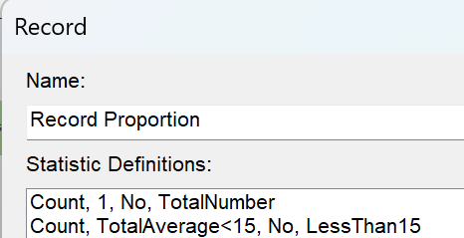
System Design
Simulating Delay
Computing Hold

Slide 14
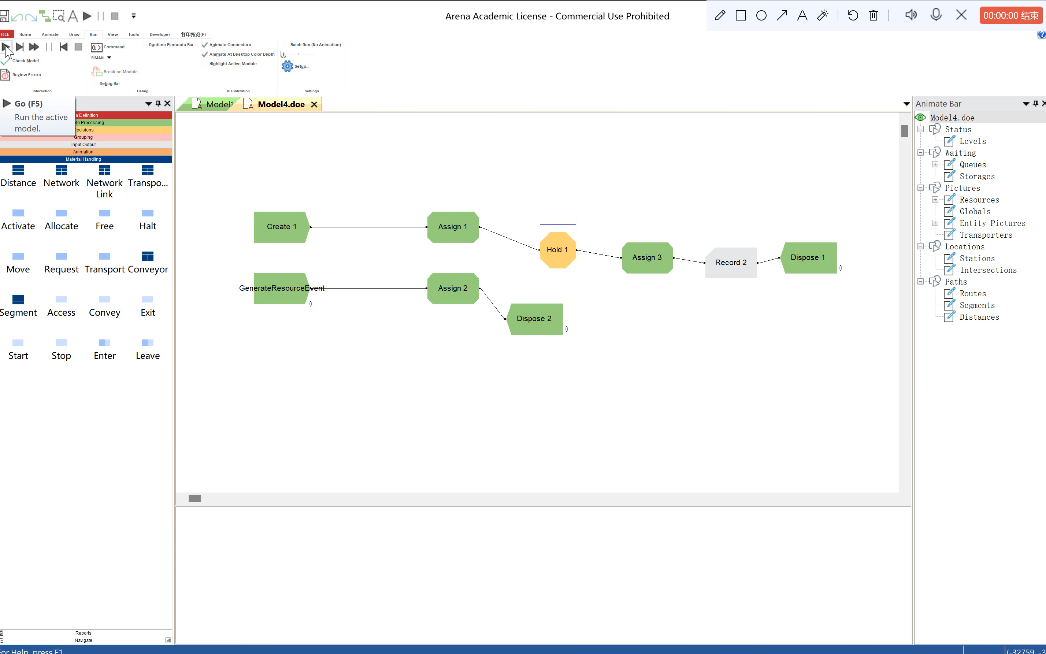
Verification & Validation
Verification with Tracing the Simulation
Verification with
Other strategies
Verification with Commonsense methods
All codes are checked by my teammates.
Since the operational model is animated, verify that what is seen
imitates the actual system.
Page9
Verification with Structured programming

Slide 15
Verification & Validation
Calibration
01
02
Face validity
Model assumptions – structural and data
03
04
Input-output transformation

Slide 16
03
Experimentation

Slide 17
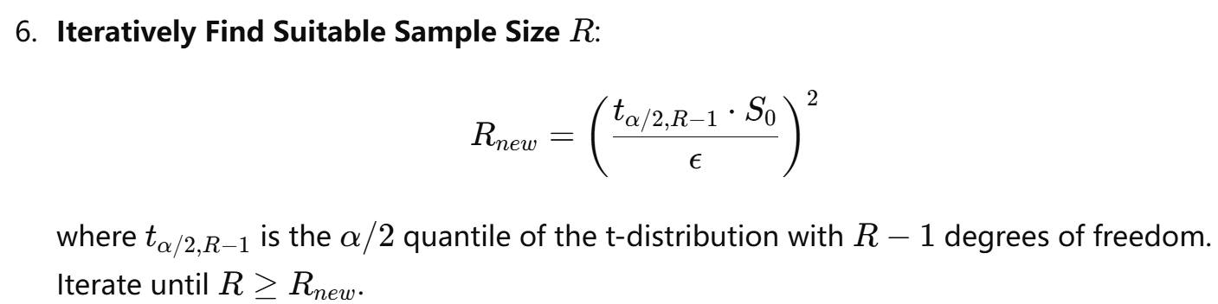
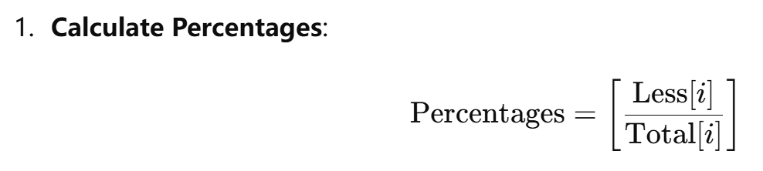
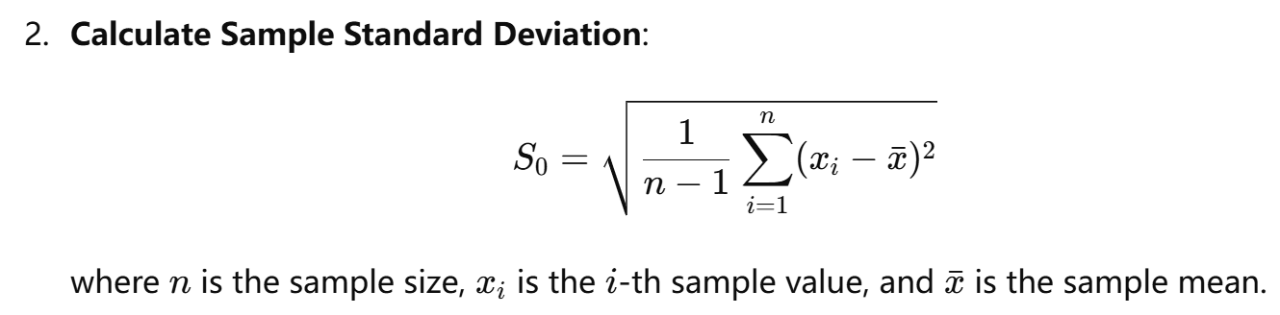
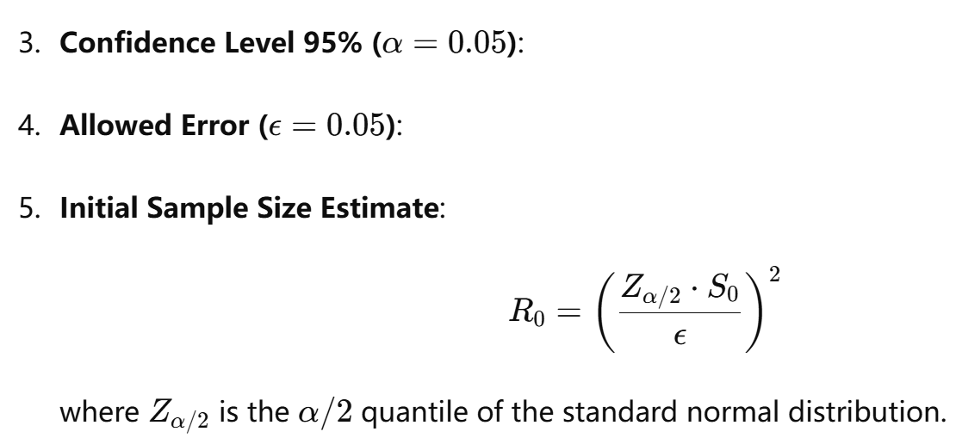
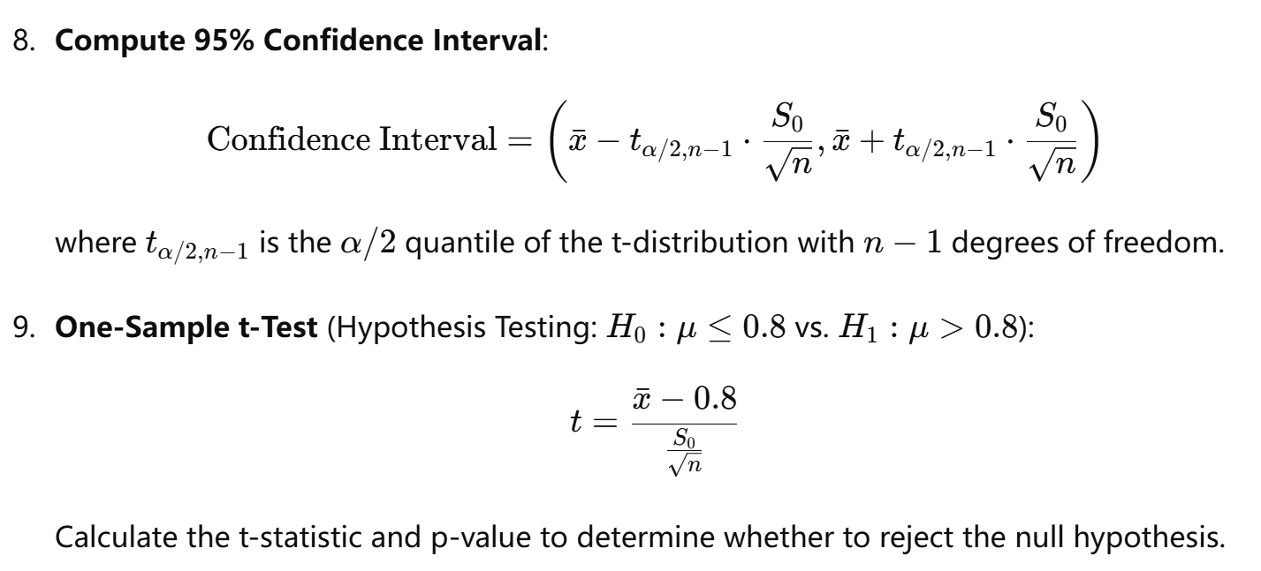
Experimentation

Slide 18
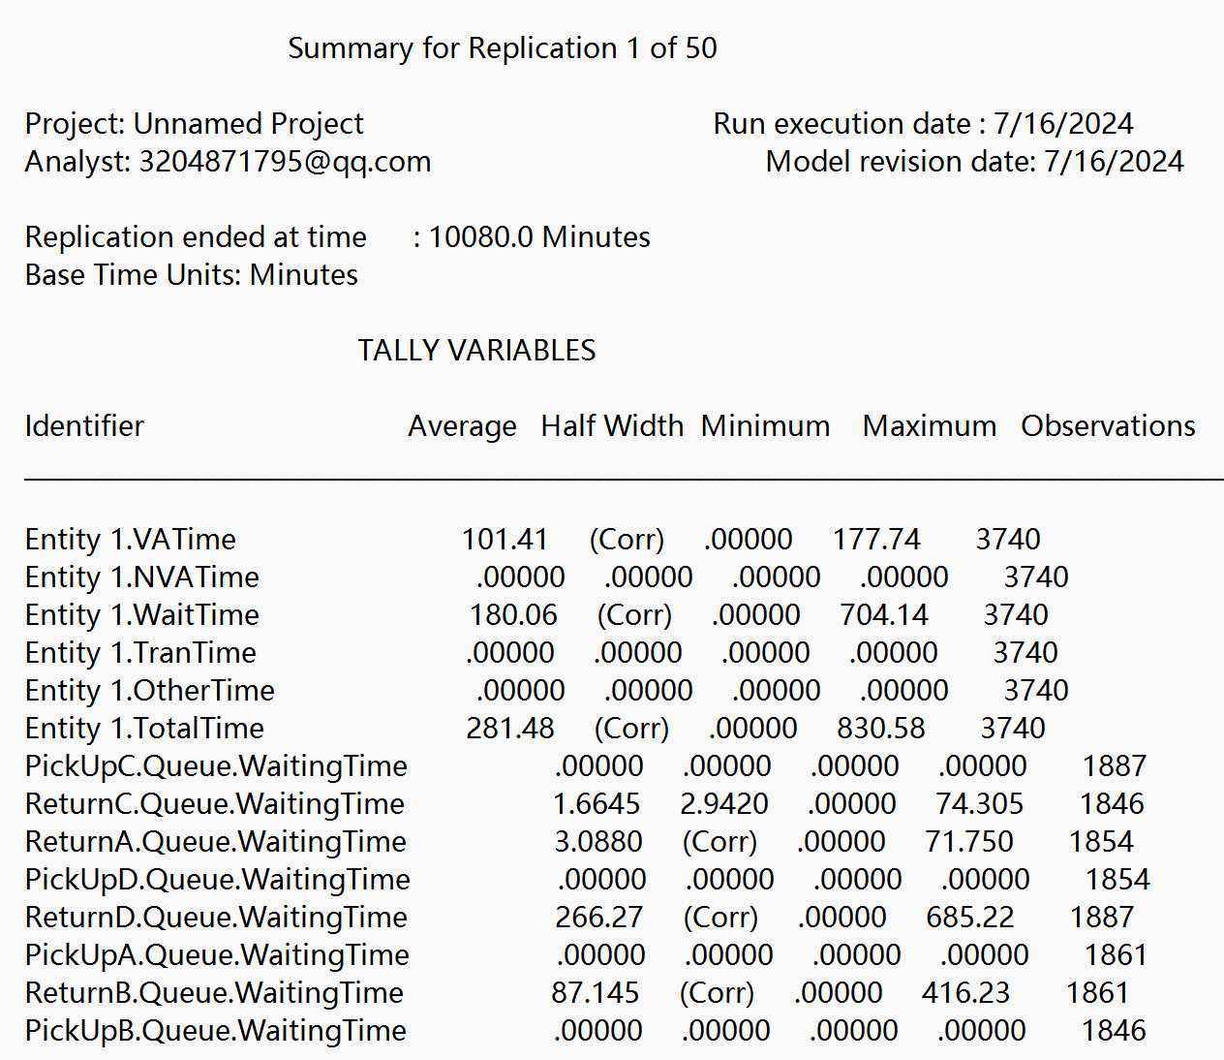
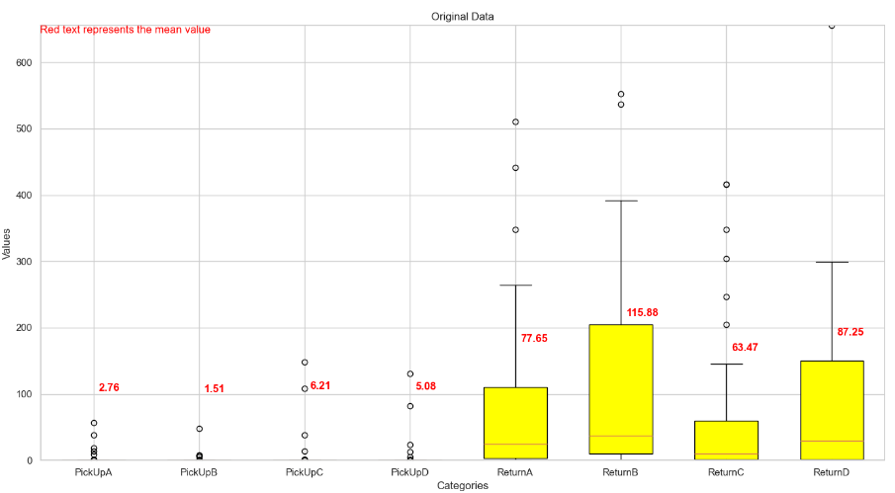
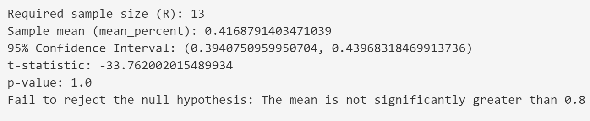
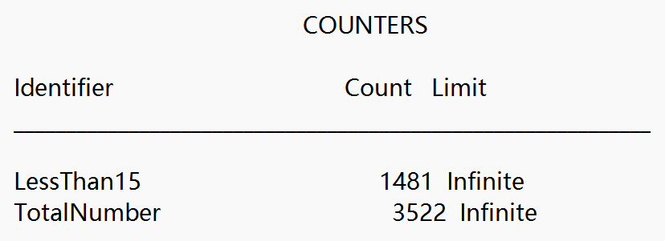
Experimentation
02
Run Original State
Make Conclusion
Analyze Output
01
03

Slide 19
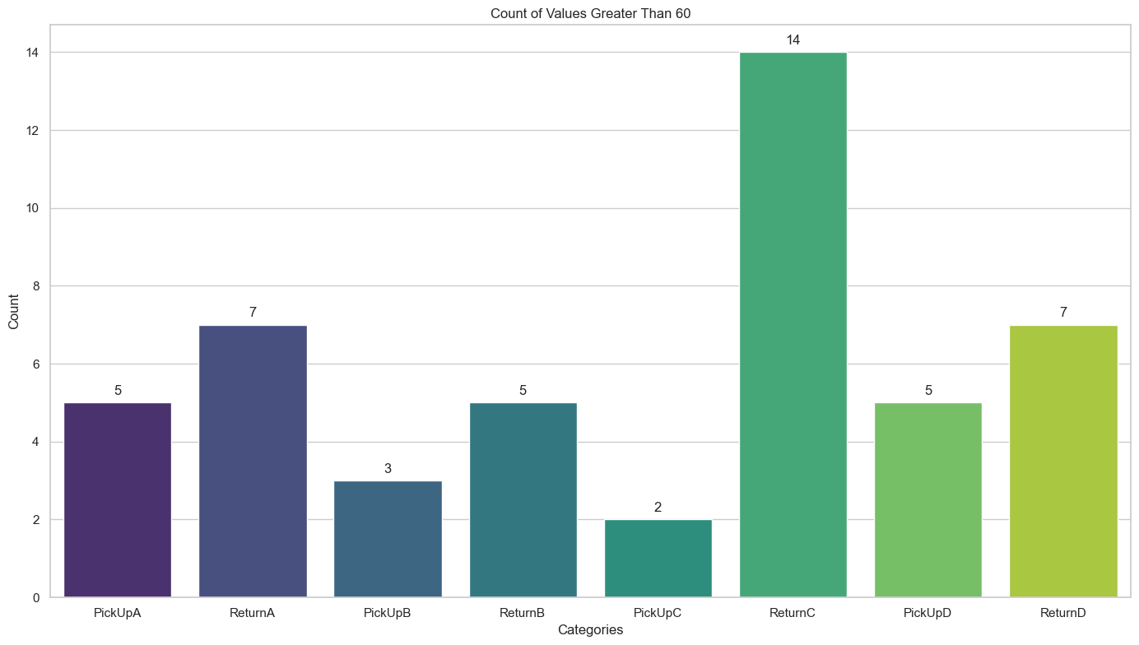
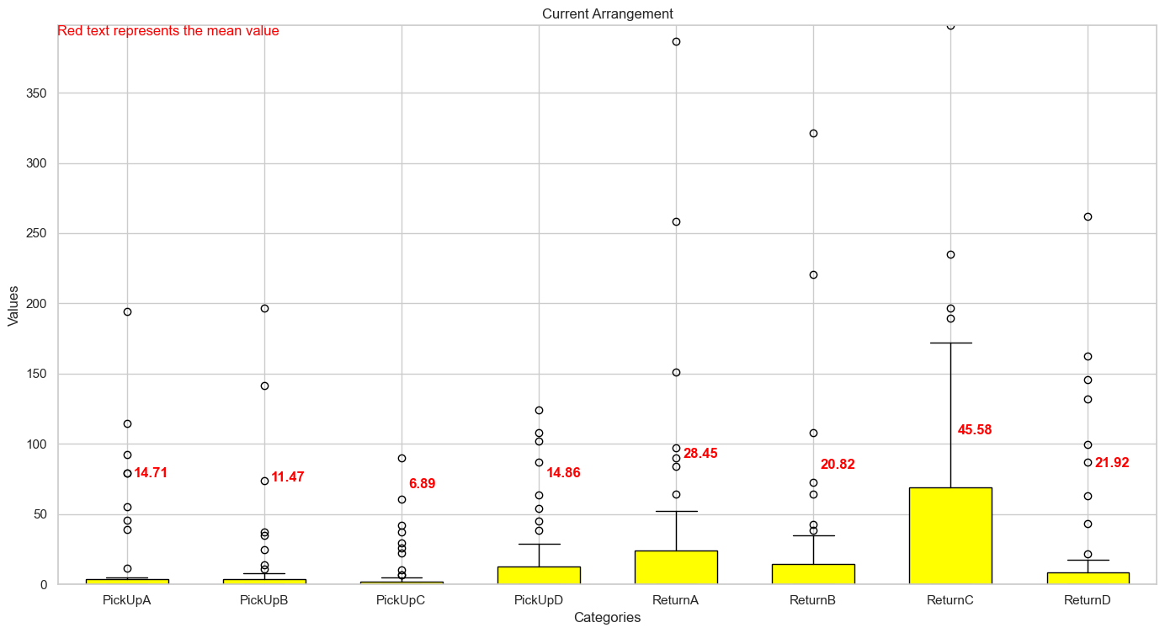
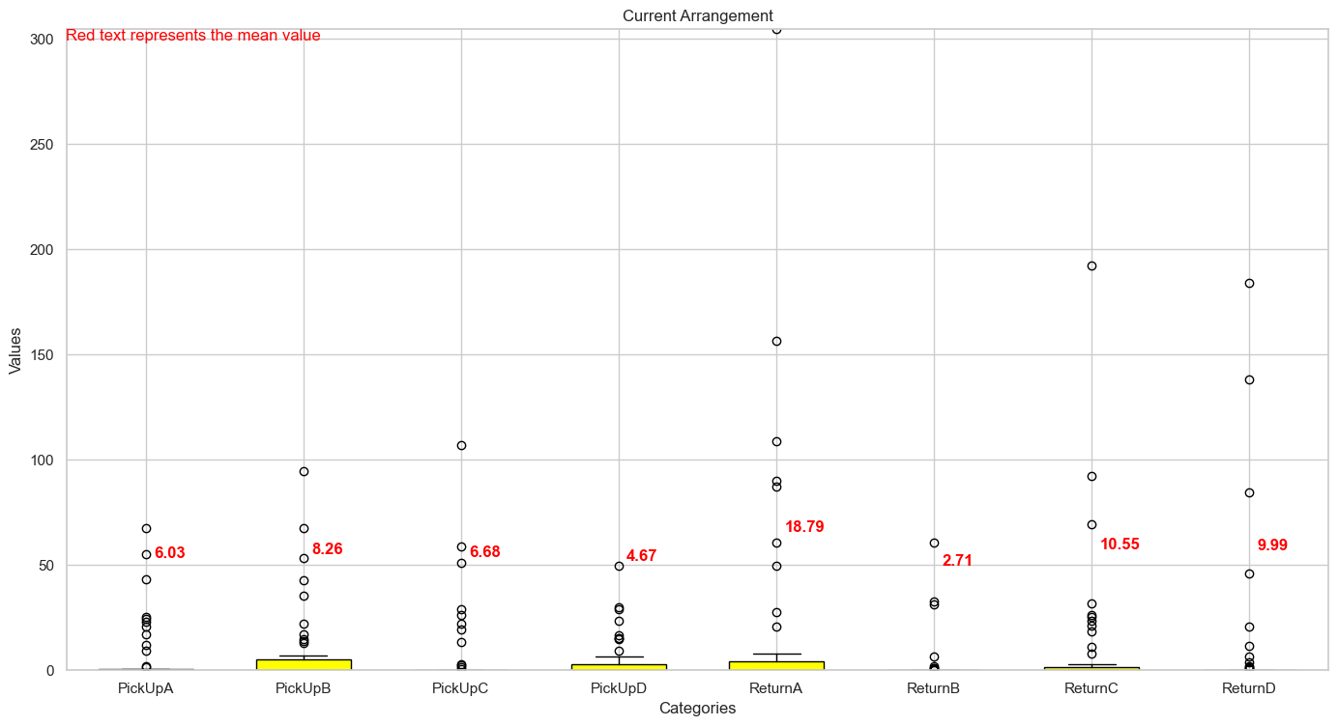
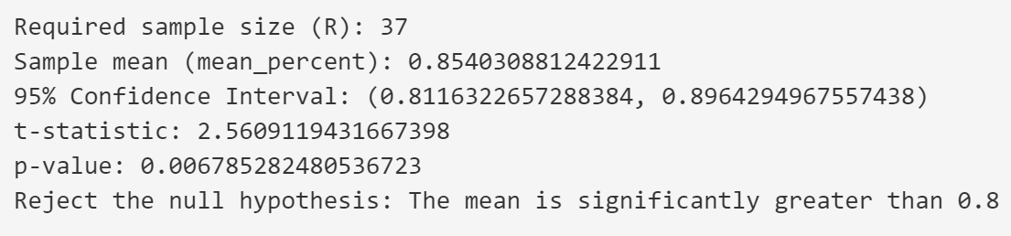
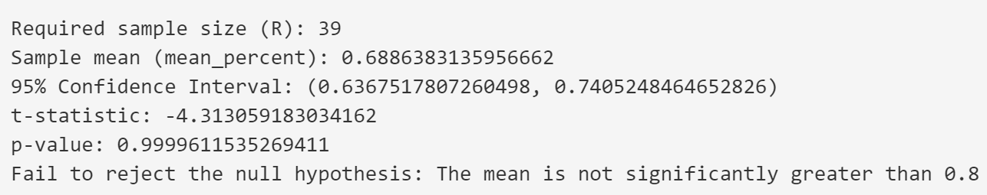
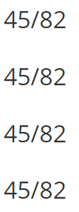
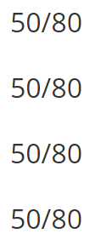
Tune parameters
Find the best arrangement
Tune the number with output
Add the number of docks
Reduce the number of bicycles

Slide 20
04
Results & Analysis

Slide 21
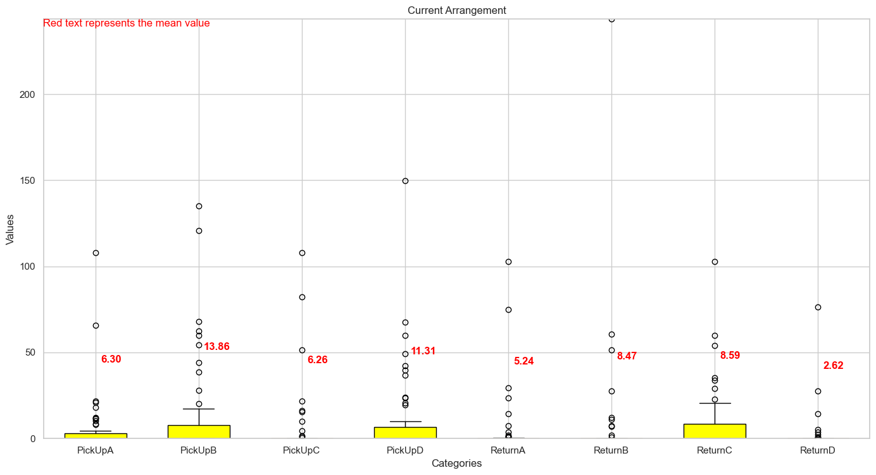
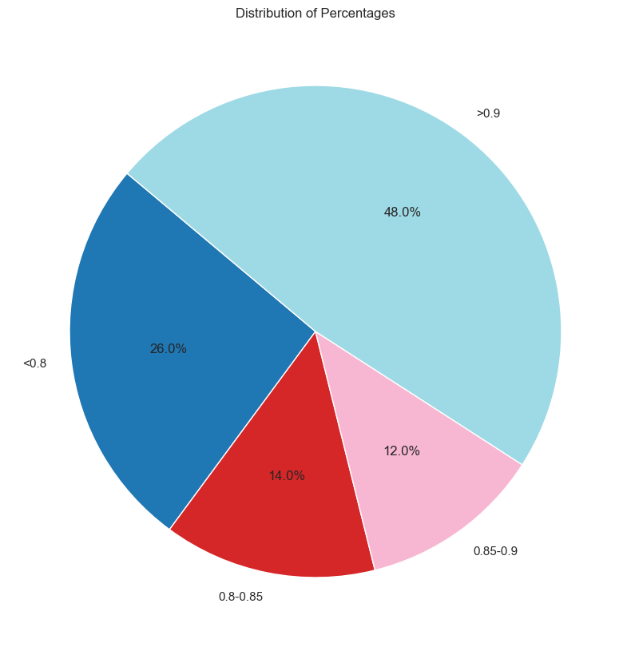
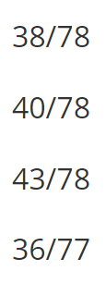
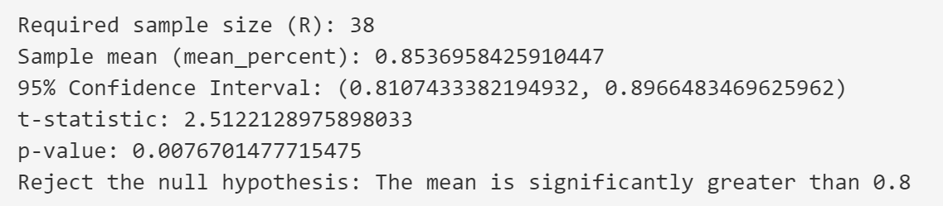
Results & Analysis
Profits:
$8150
$6200

Slide 22
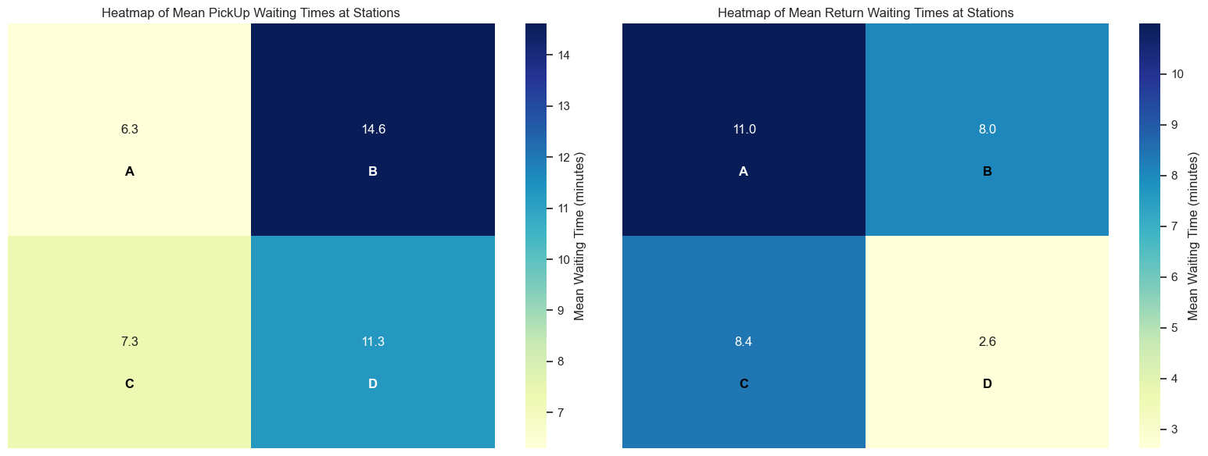
Results & Analysis
What if we reduce 1 bicycle in A station?

Slide 23
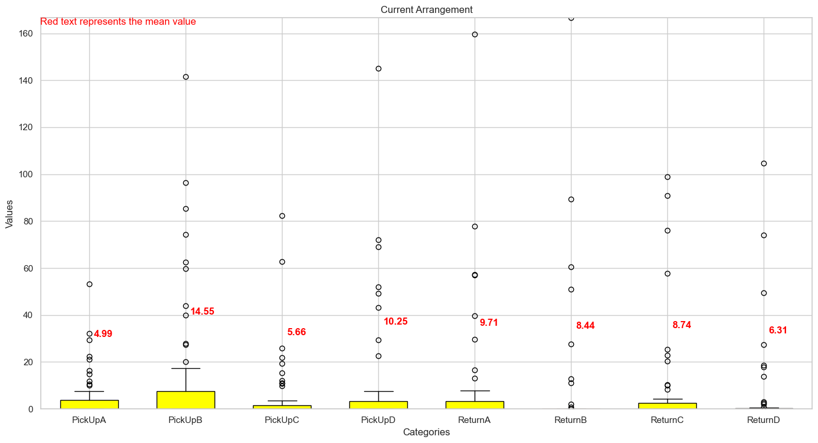
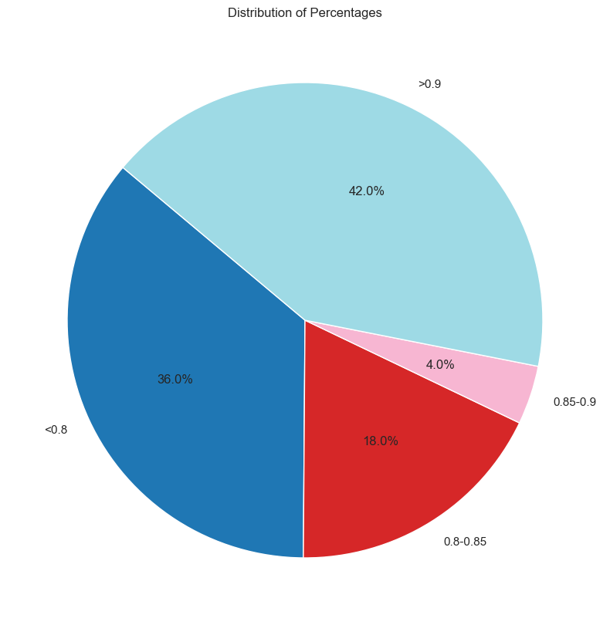
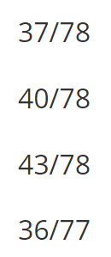

Results & Analysis
A small change can trigger a transformation in the entire system.

Slide 24
05
Conclusion

Slide 25


Conclusion
Additionally, we also have done further experiments to find the most profitable solution, under the circumstance that numbers of bicycles and docks are not the same for each attraction:
The average waiting time for renting or returning bicycles exceeded one hour in total for a significant portion of tourists. This indicates that the current system is not satisfactory according to the management's criteria.
02
04
01
Assuming the bike is sold at $50, we could earn $8150.
03
We successfully created a model of the bicycle rental system using Arena and conducted thorough simulations with satisfactory verified and validated.
To have the average waiting time of over 80% tourists less than 15 minutes, we need:
Assuming the bike is sold at $50, we could earn $6200.

Slide 26
Thanks for your watching
Presentation
Song Ziye Huang Yuyang Tu Teng Ji Xiangtian

